Slide 1

Credit Card Approval Prediction
By: Bean, Dennis, Leora, Vincent, Zoey

Slide 2


Lack of Transparency
How do banks decide who to approve or reject?
Banks have complex algorithms to determine whether an individual will be approved for a credit card or not
But what do these algorithms use to judge a person’s risk level?

Slide 3

Credit Card Approval Dataset
What dataset are we working with?
6
15
Categorical
Numerical

Slide 4



Which models were used?
The different classification models used for approval prediction
Logistic Regression
Decision Tree
Random Forest &
XGBoost

Slide 5
Which models were used?
The different classification models used for approval prediction
Logistic Regression
Decision Tree
Random Forest &
XGBoost

Slide 6
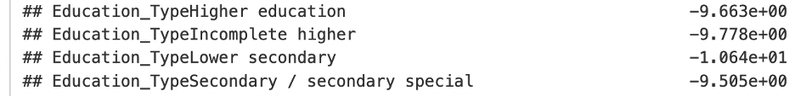
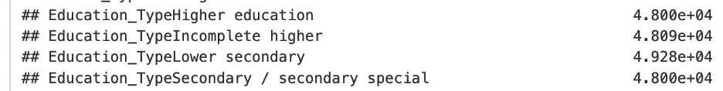
Logistic Regression
We chose 6 independent variables, which are:
Gender, Income, Education, Age, Years of Work Experience, and Good Debt.
The Education Type has a negative impact on the application status.
However, if we run all the variables together, Education Type becomes a helpful element when applying for a credit card.

Slide 7
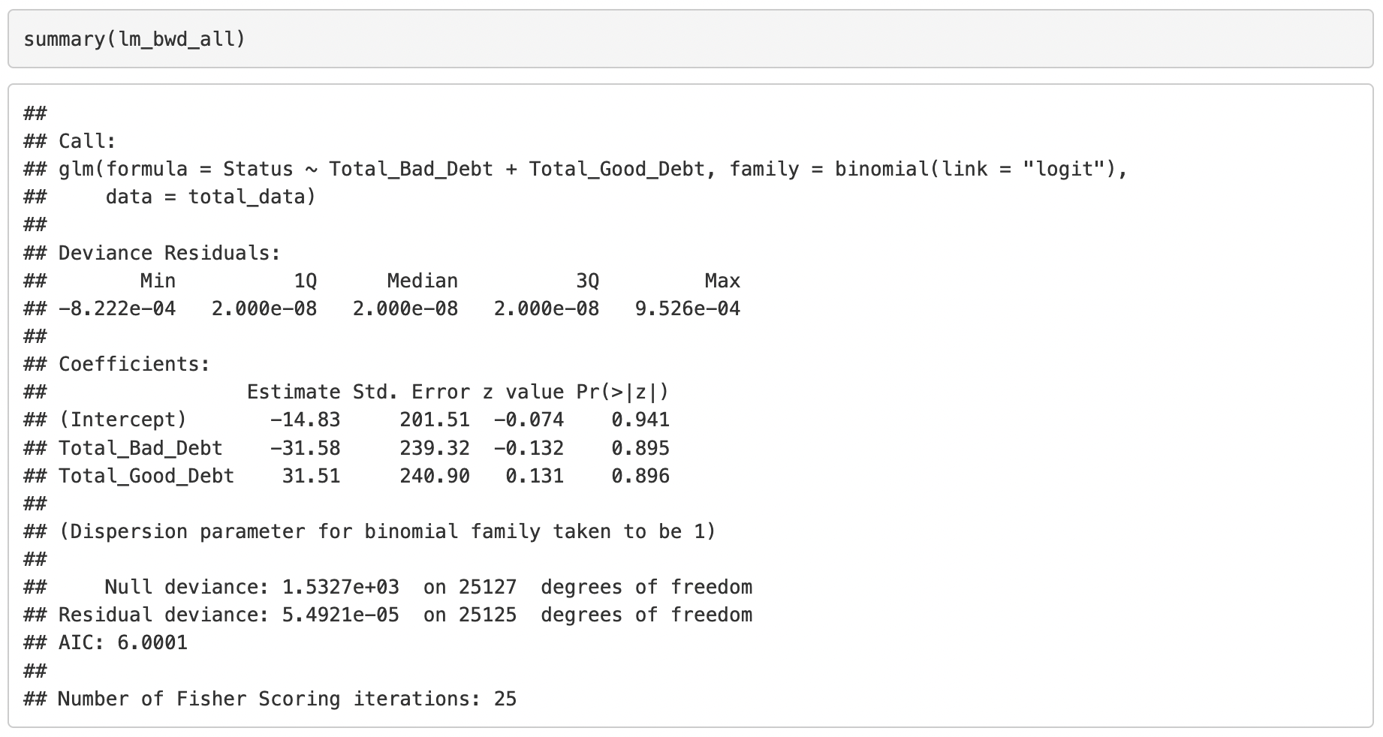
Logistic Regression
For logistic regression, we know that good and bad debt records are the most important.
We can use backward selection to get that answer easily.

Slide 8
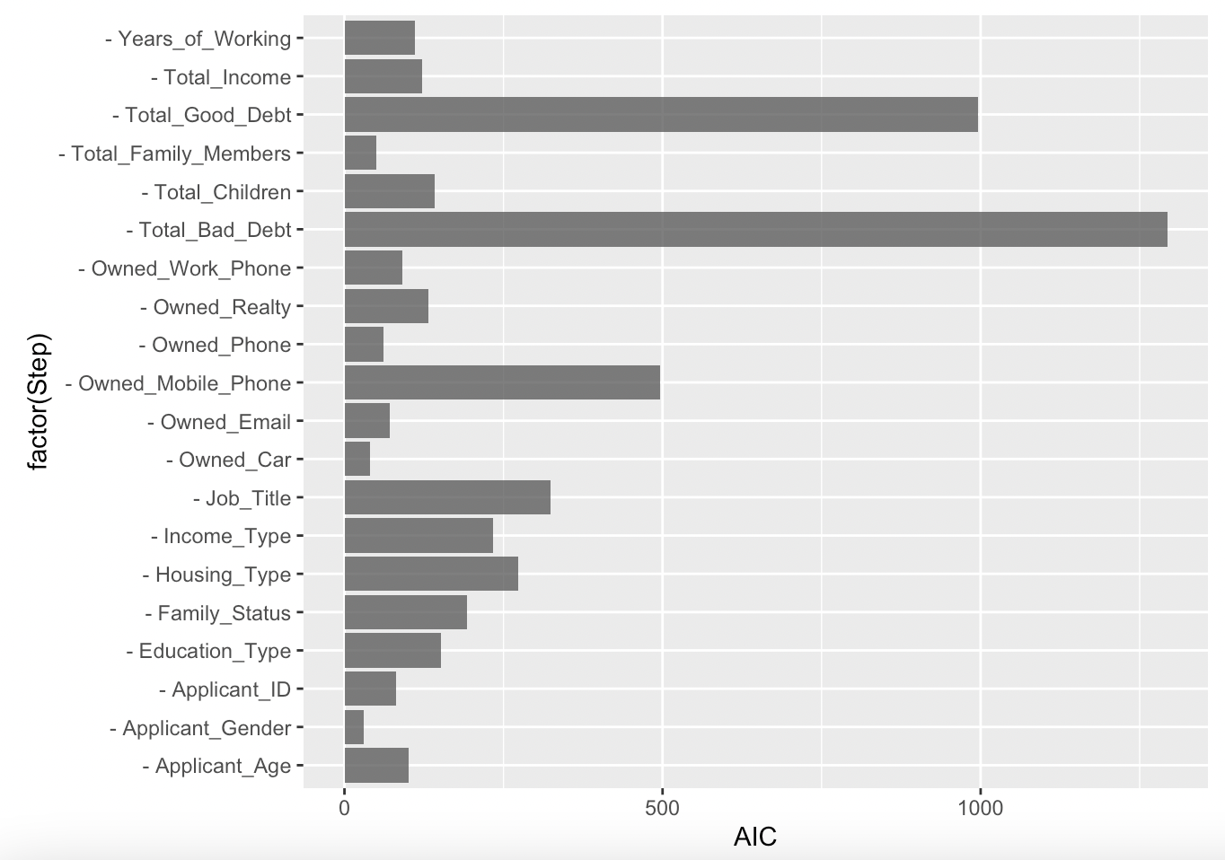
Logistic Regression
Using visualization is also a good way to notice the huge difference between important ones and not important ones.

Slide 9
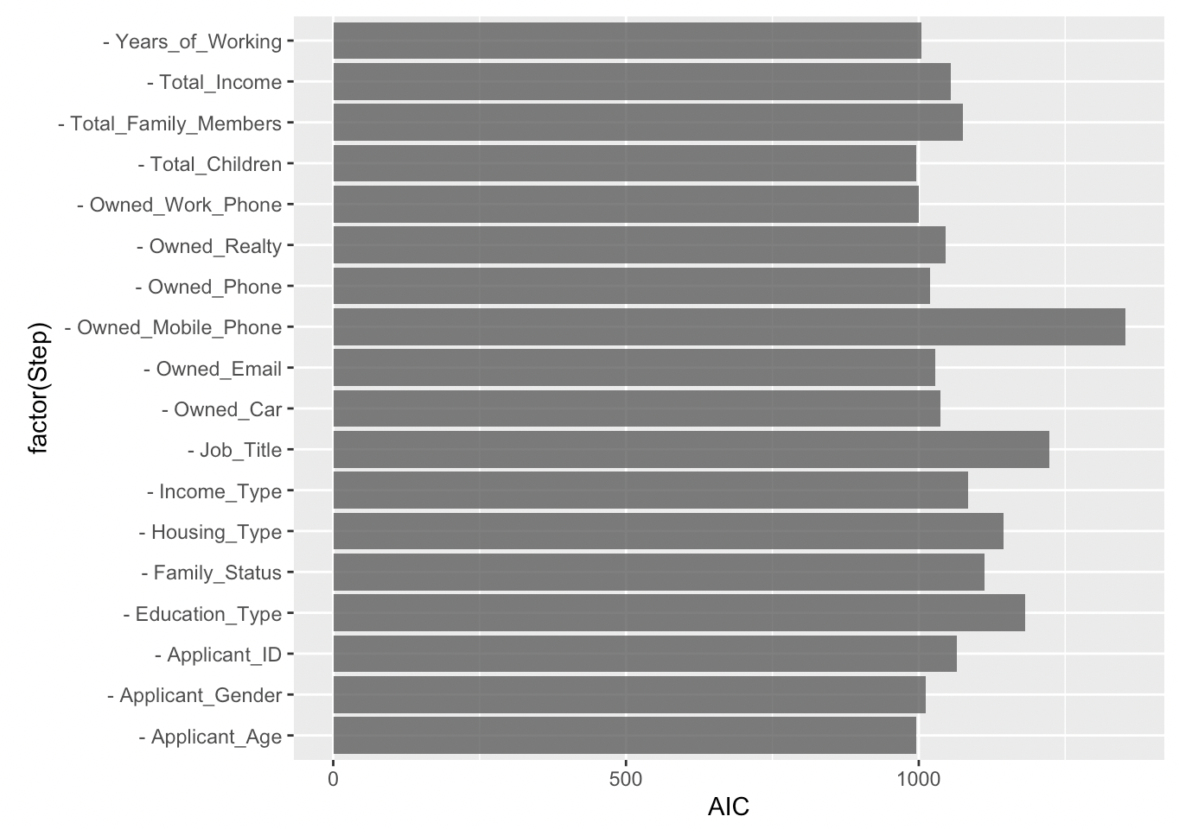
Logistic Regression
Then remove “Total_Bad_Debt” and ”Total_Good_Debt”.
In summary, “Owned_Mobile_Phone”, “Job_Title” and “Education_Type” are now the top 3.

Slide 10
Which models were used?
The different classification models used for approval prediction
Logistic Regression
Decision Tree
Random Forest &
XGBoost

Slide 11
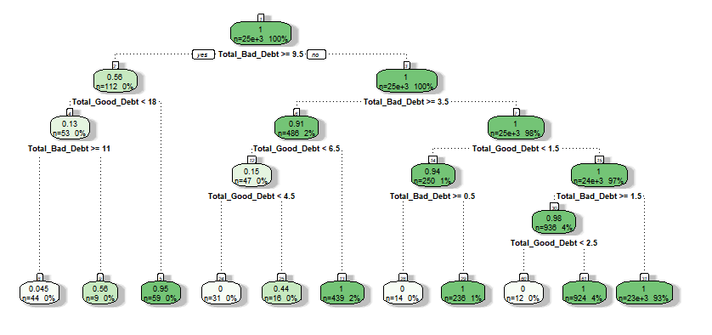
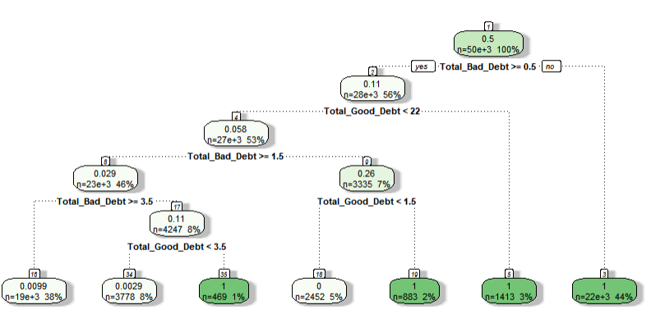
Initial decision tree (all hyperparameters are default and no processing of the data)
The final decision tree (much more concise)

Slide 12
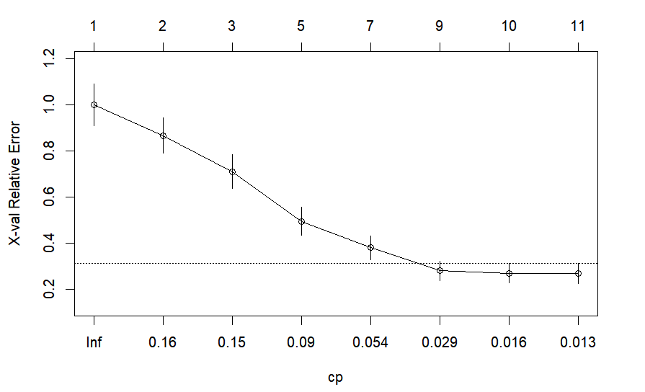
Find the best cp value

Slide 13
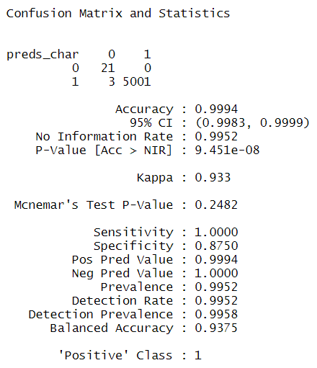
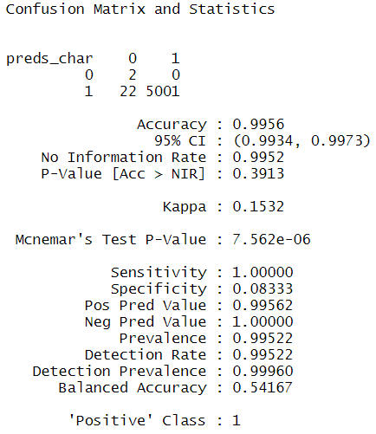
Set the threshold value to 0.5
Set the threshold value to 0.3

Slide 14

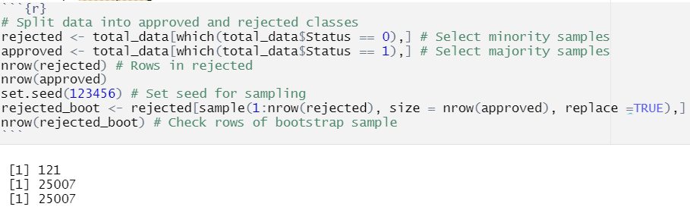
The number of ‘0’ and ‘1’ contained in status in the raw data is very imbalanced
Bootstrap resampling

Slide 15
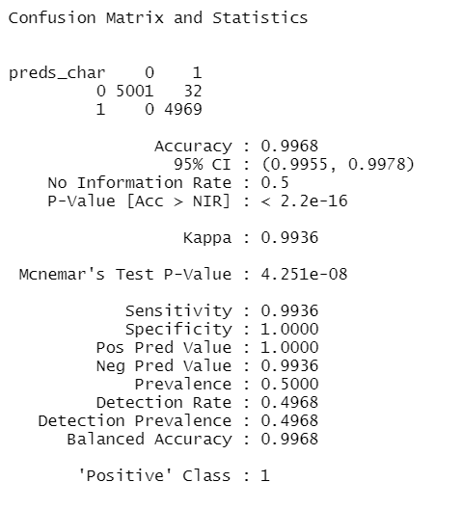
Decision Tree
Final Evaluation

Slide 16
Which models were used?
The different classification models used for approval prediction
Logistic Regression
Decision Tree
Random Forest &
XGBoost

Slide 17
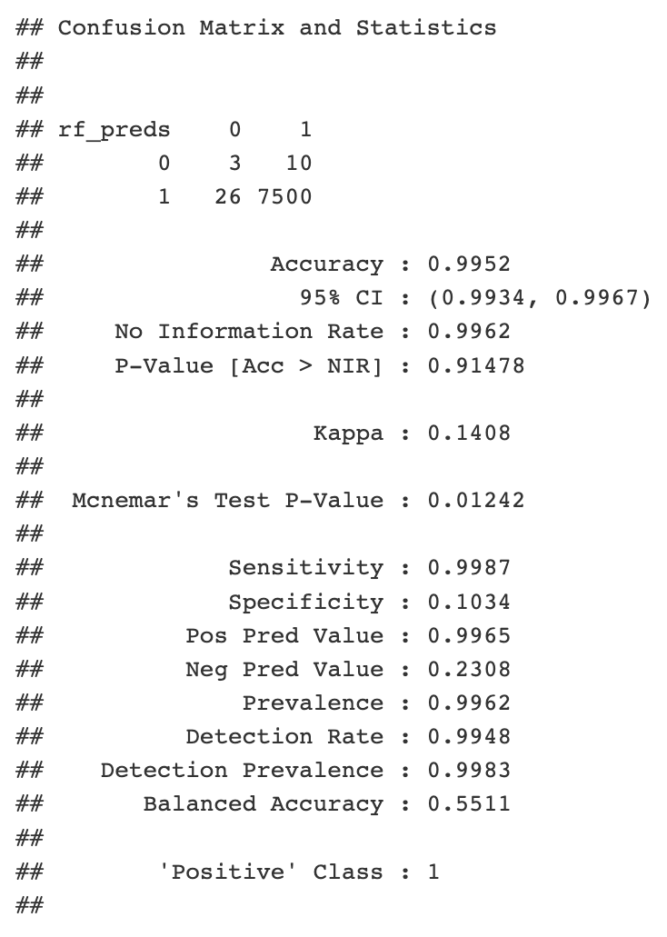
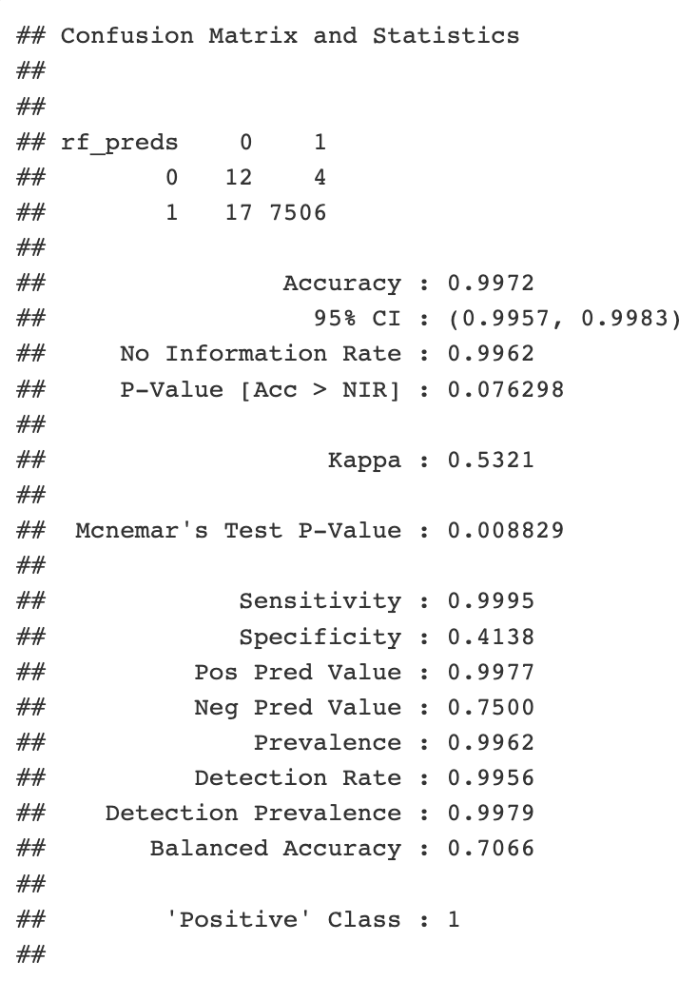
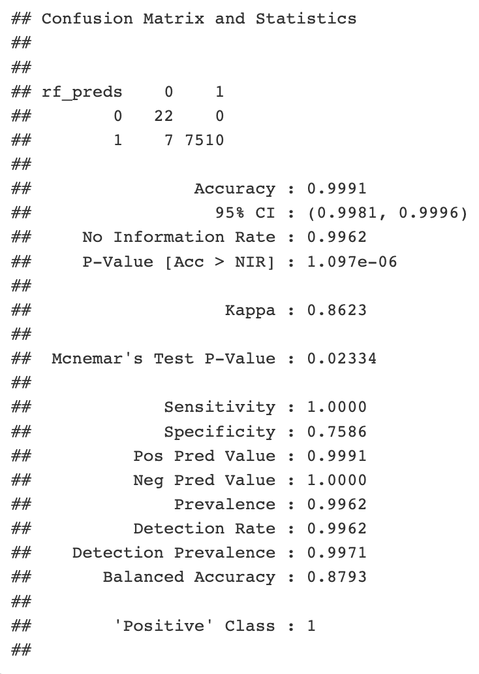
Random Forest
Random Forest Without Good or Bad Debt
Random Forest Without Good Debt
Random Forest with Both Good and Bad Debt
Balanced Accuracy
Balanced Accuracy goes down as we take away significant variables
0.5511
0.7066
0.8793
Best

Slide 18
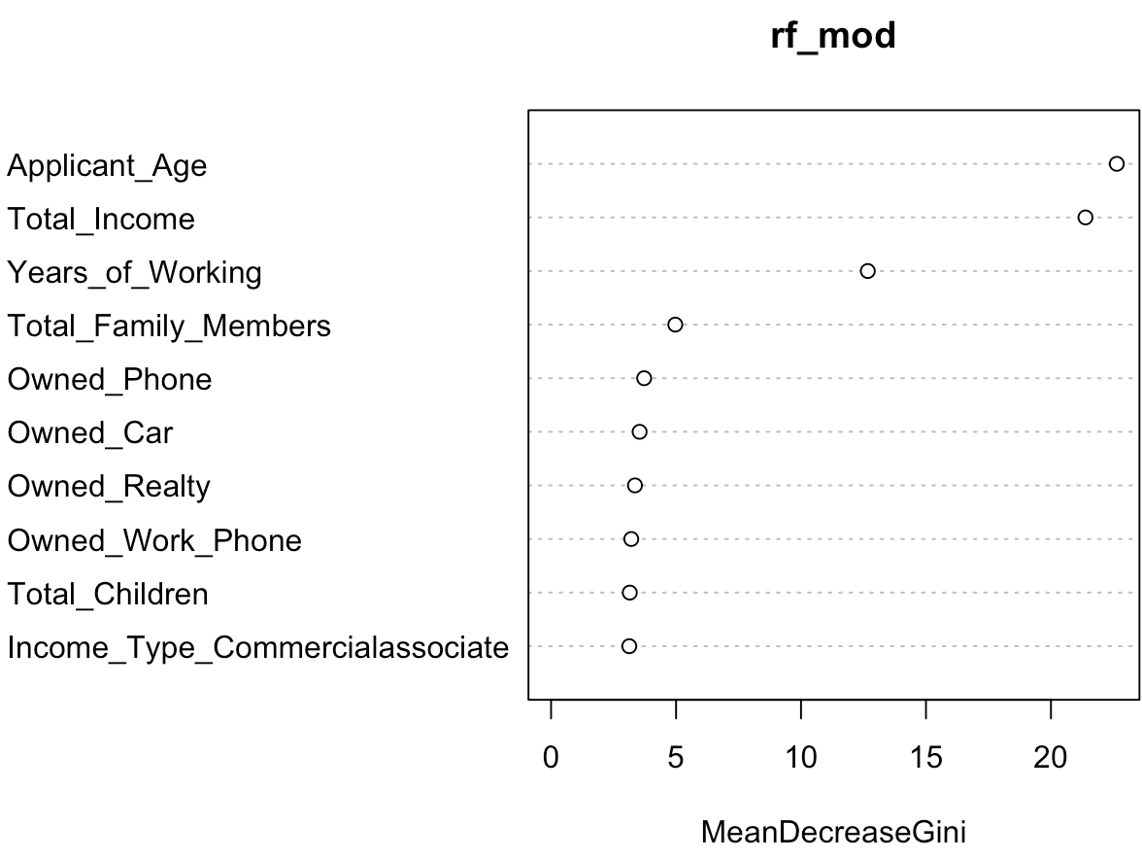
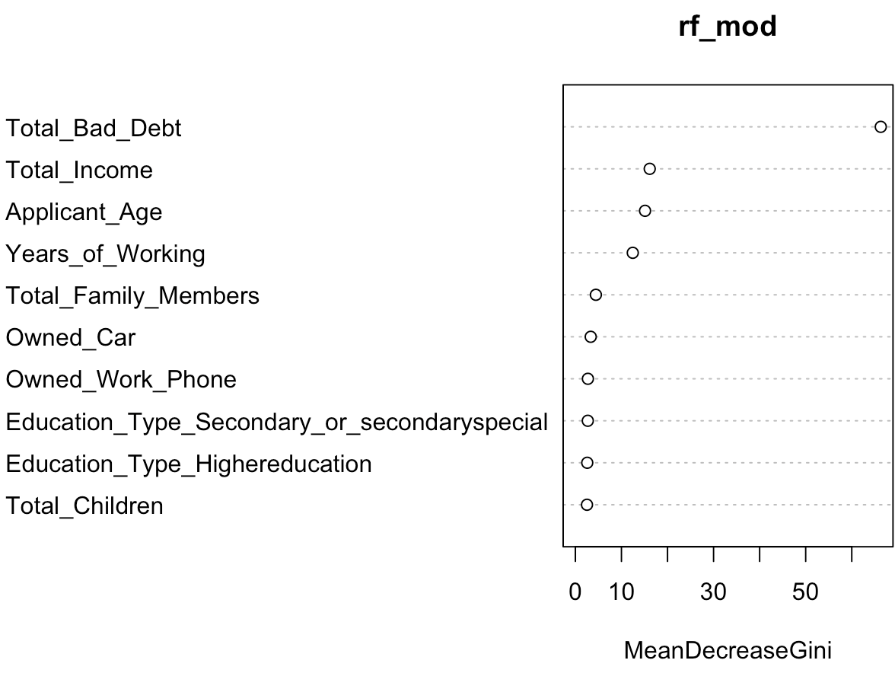
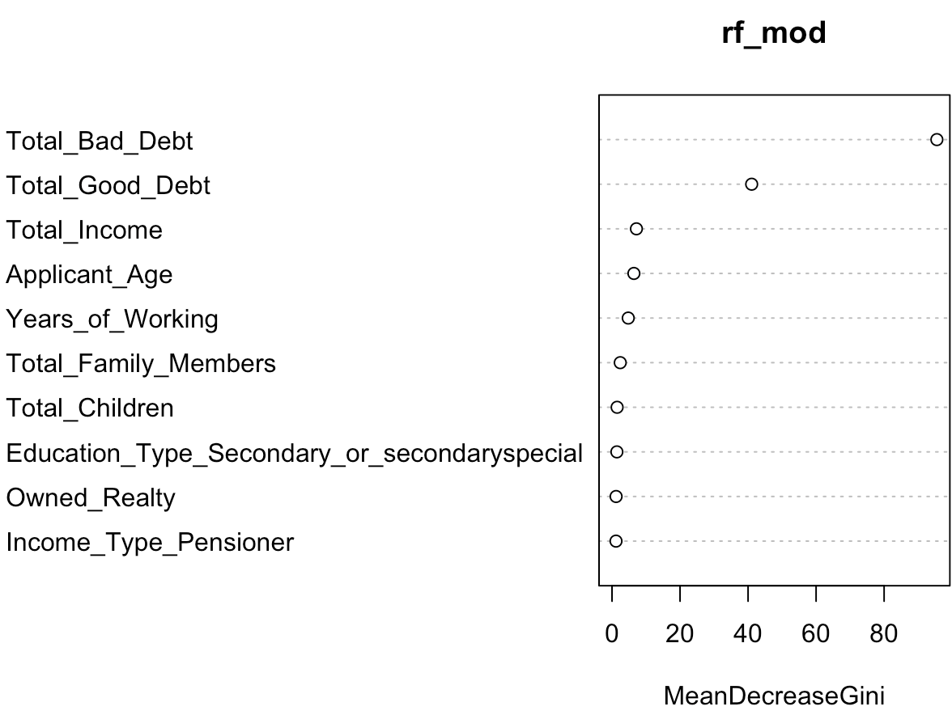
Random Forest Variable Importance
Random Forest Variable Importance
Random Forest Without Good or Bad Debt
Random Forest Without Good Debt
Random Forest with Both Good and Bad Debt
Total_Bad_Debt and Total_Good_Debt are by far the most important features of the model with Applicant_Age, Total_Income, and Years_of_Working also being somewhat significant.

Slide 19
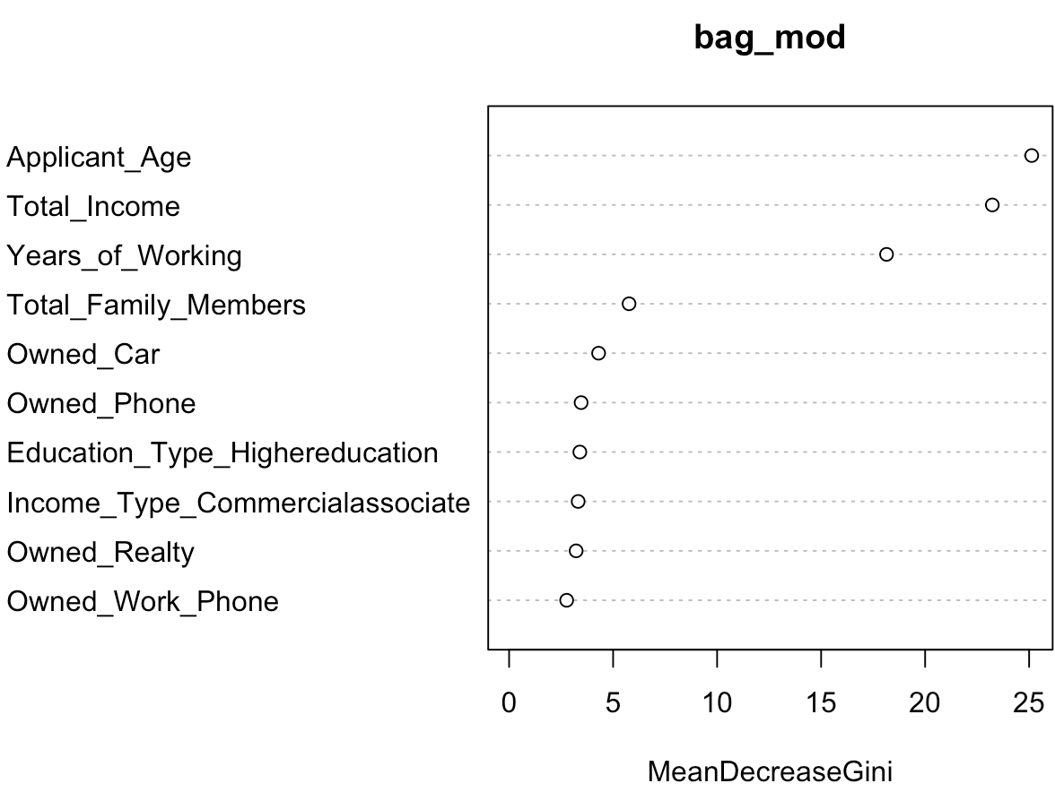
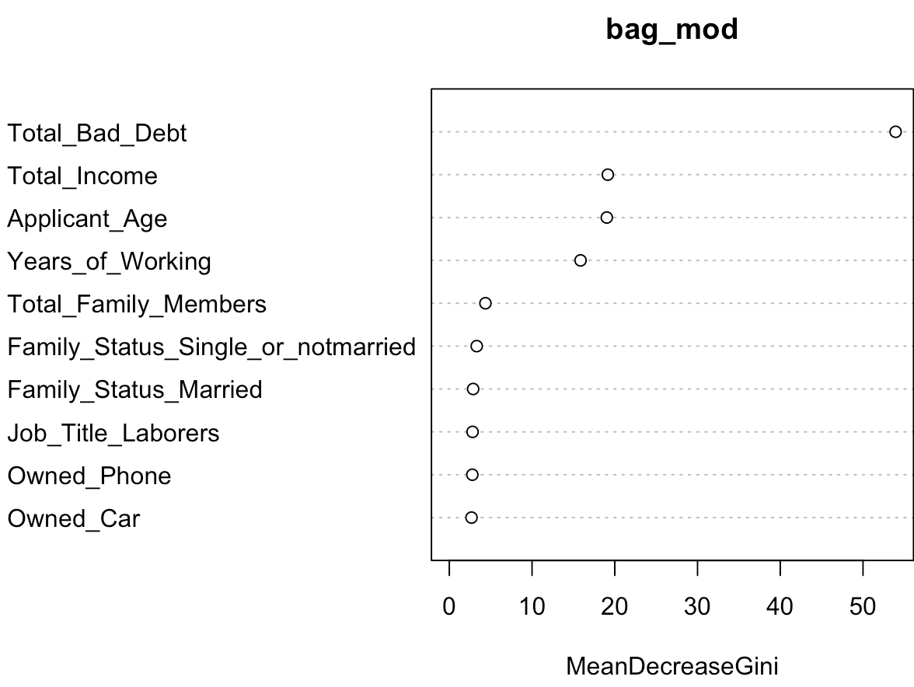
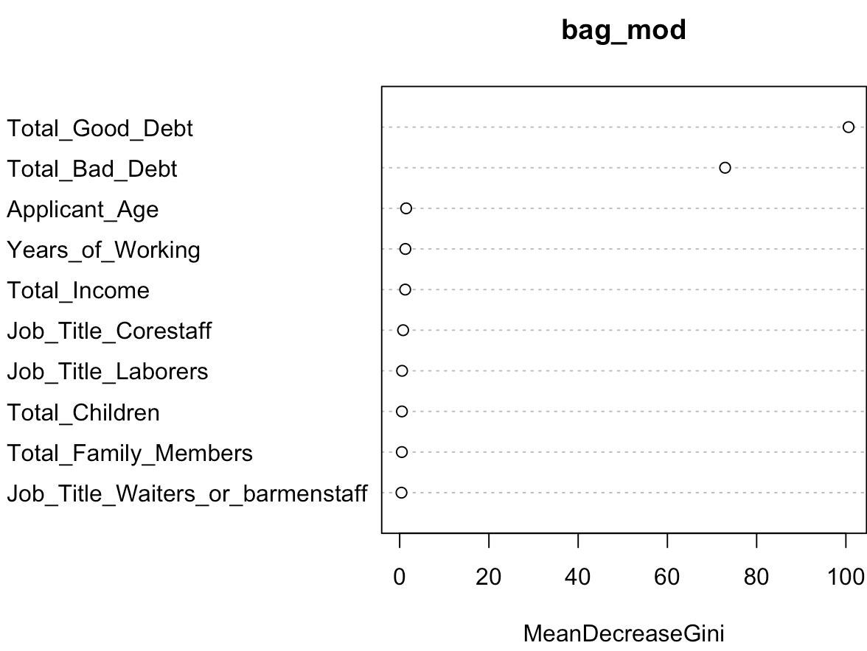
Checking with Bagging
Random Forest Variable Importance
Bagging Without Good or Bad Debt
Bagging Without Good Debt
Bagging with Both Good and Bad Debt
No visible difference which shows that our random forest model is quite stable and reliable

Slide 20
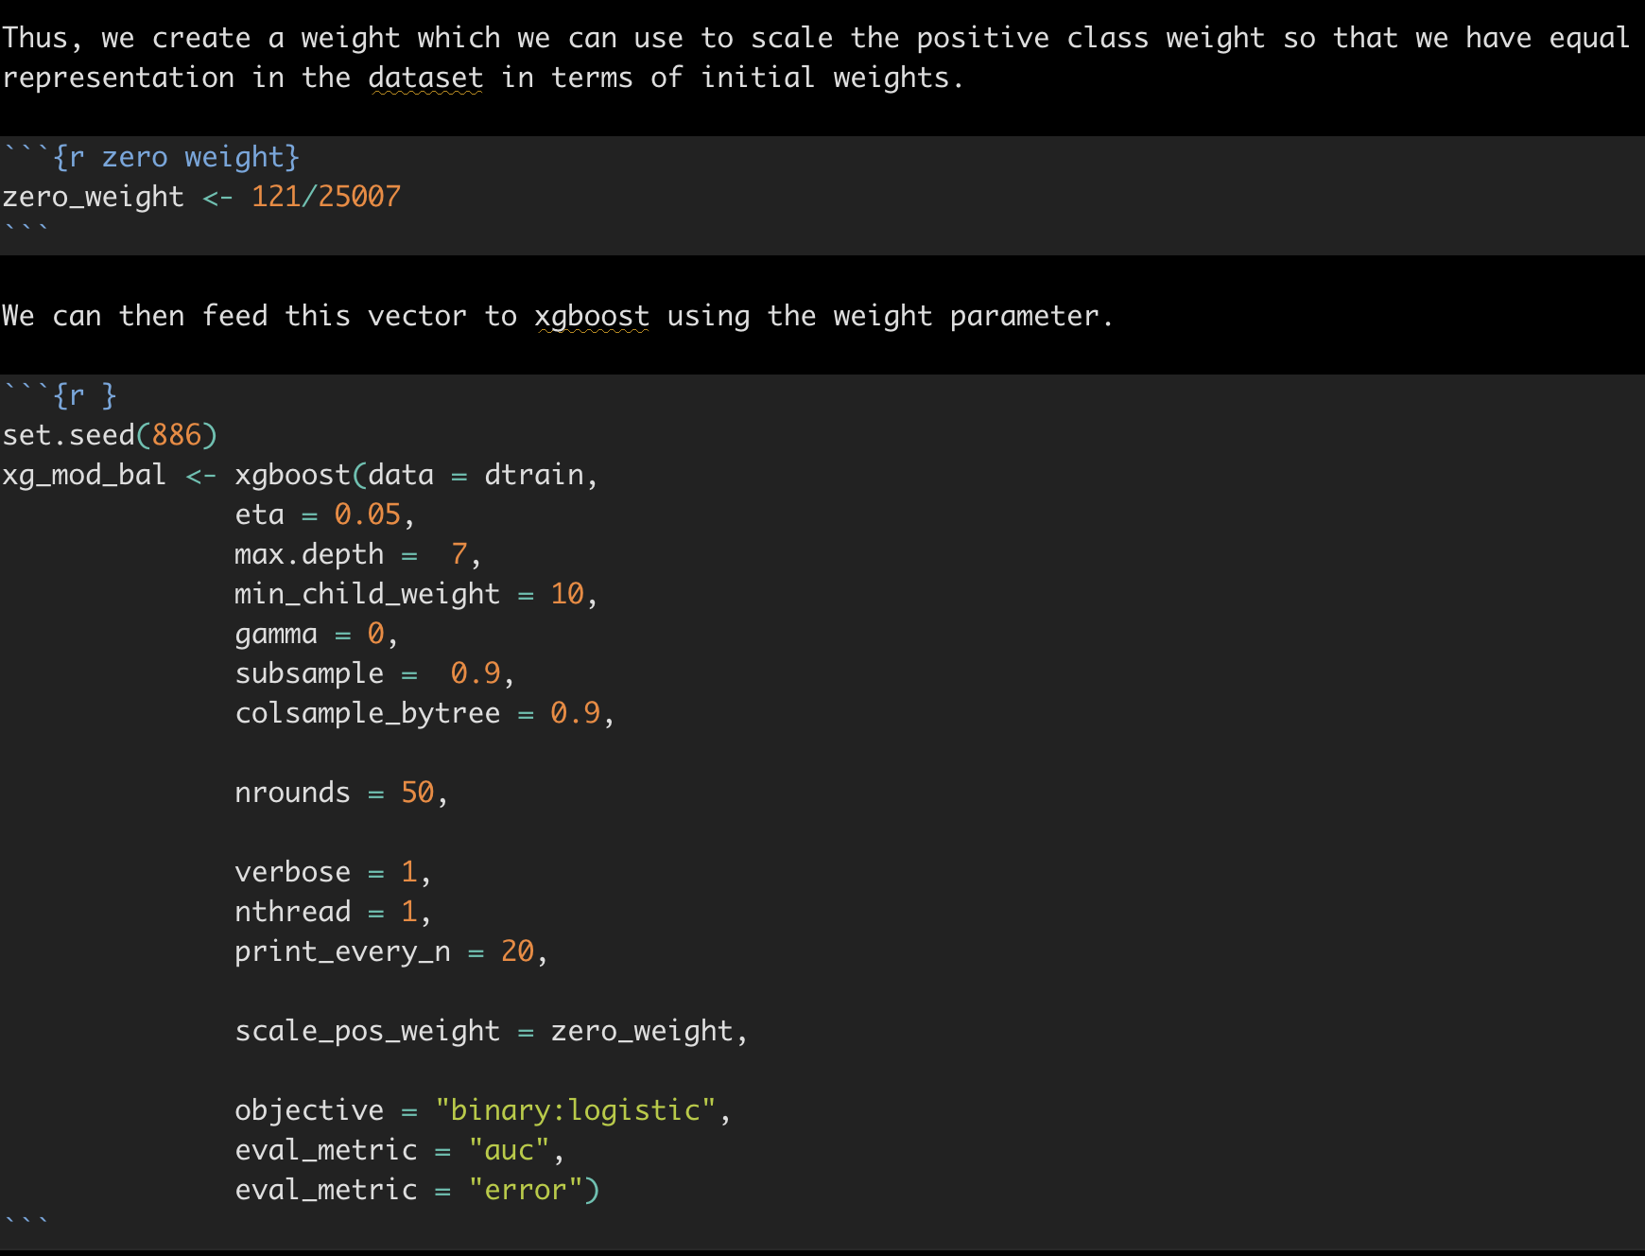
Imbalanced Data Problem
We have 121 rejection cases and 25007 approval cases.
XGBoost

Slide 21
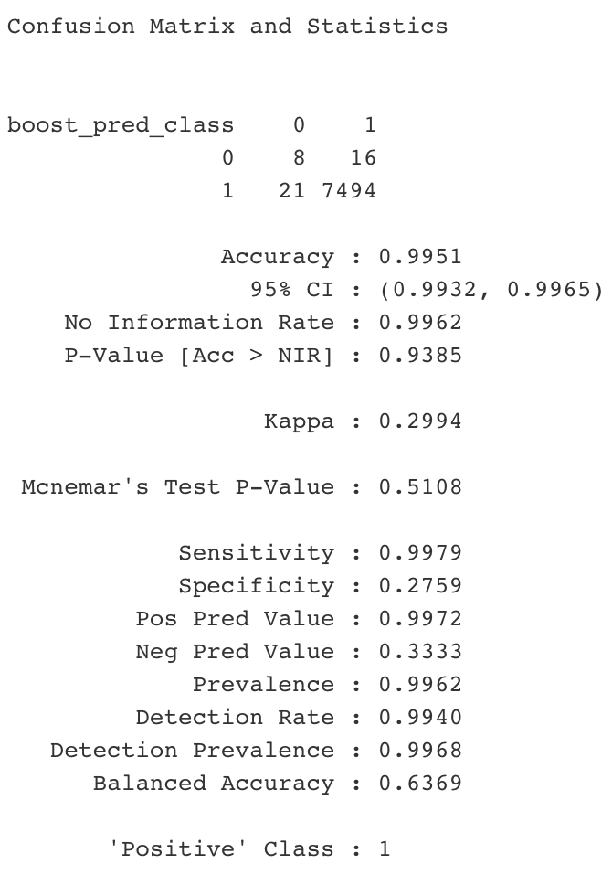
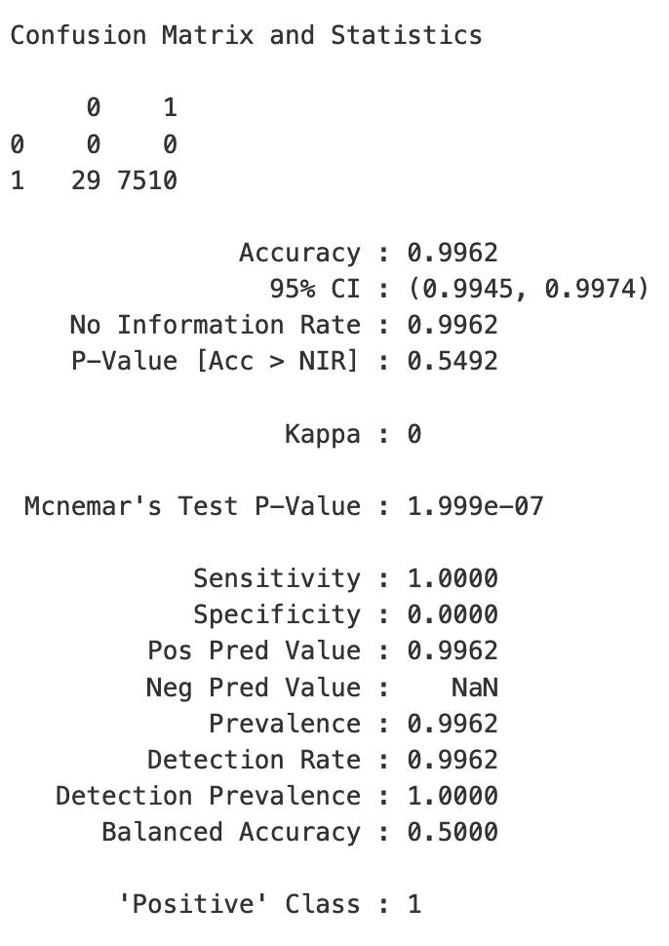
Imbalanced Data
Balanced Data
XGBoost
Model Accuracy

Slide 22
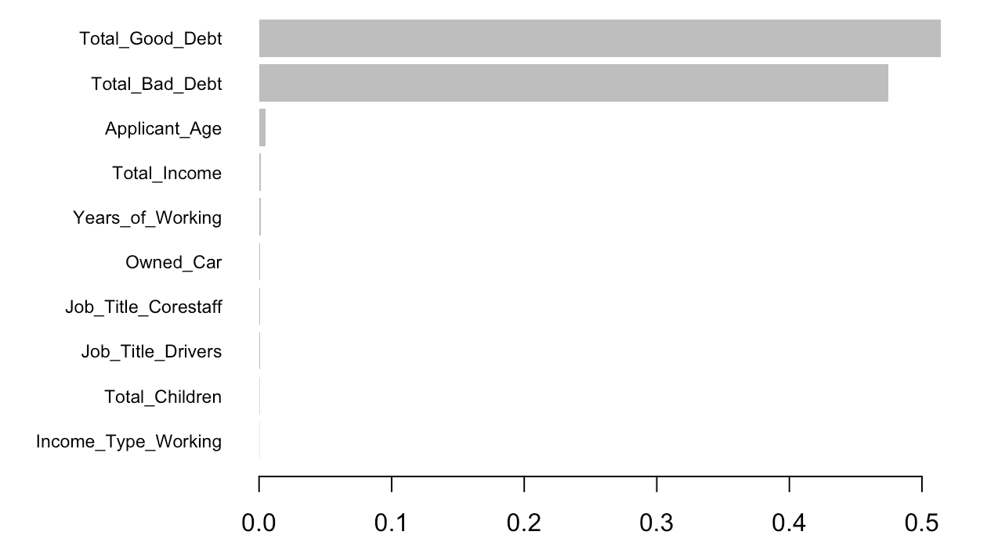
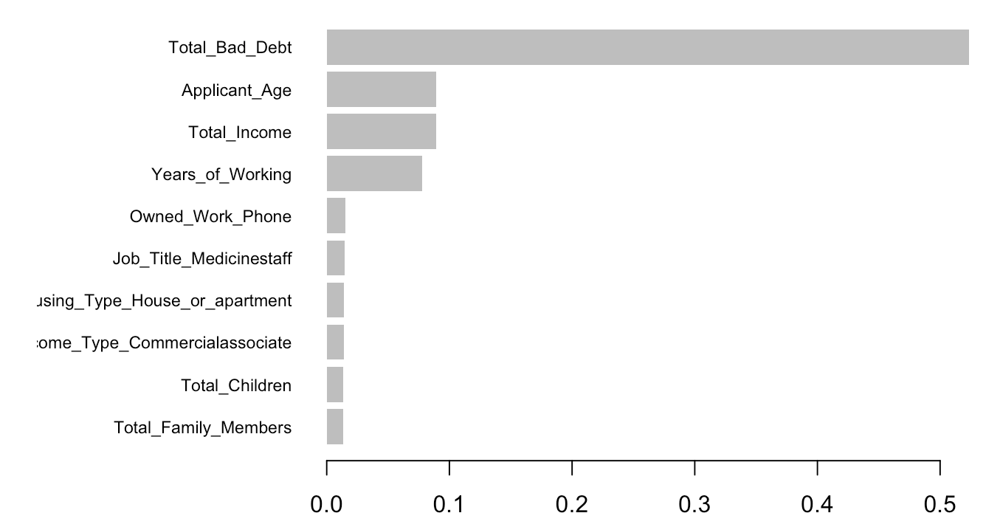
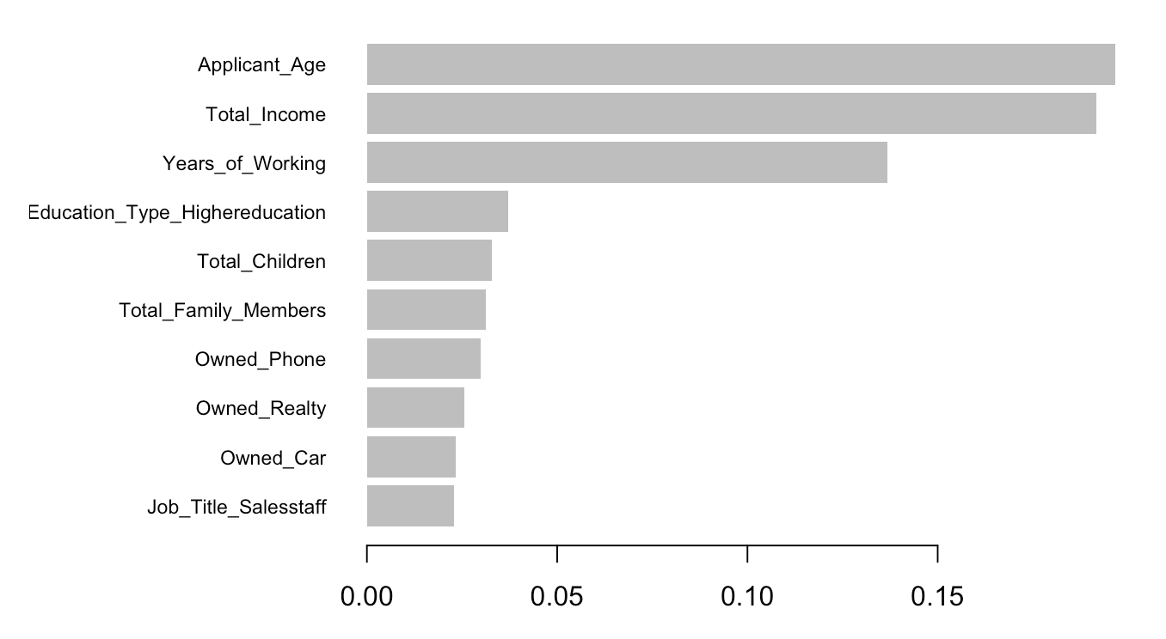
Variable
Importance
(Balanced Data)
XGBoost

Slide 23

Which model is the ideal one ?
Logistic Regression
Decision Tree
Random Forest &
XGBoost
Important variables: Total_Good_Debt, Total_Bad_Debt, Applicant_Age, Total_Income, Years_of_working

Slide 24

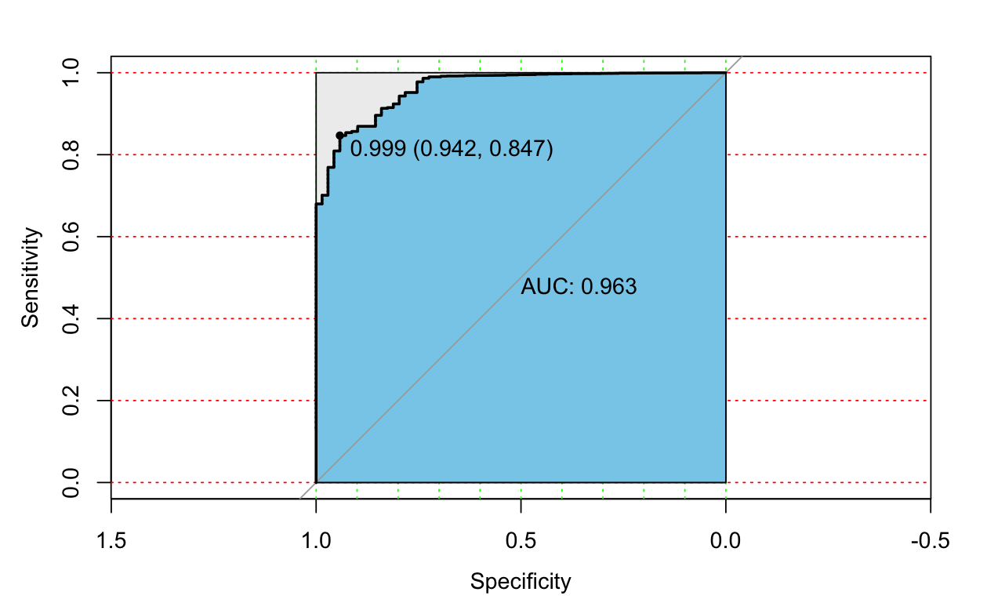
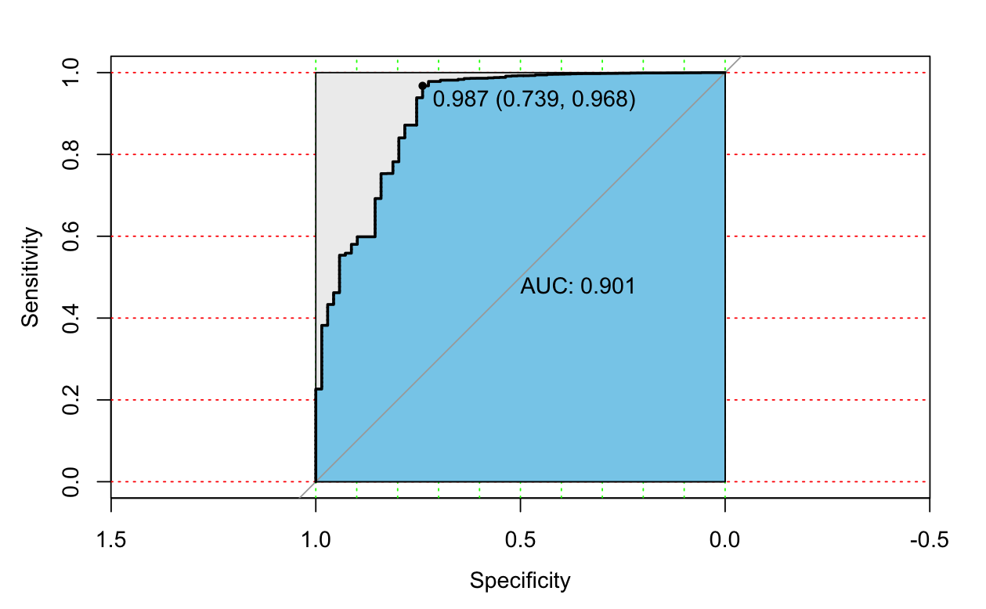
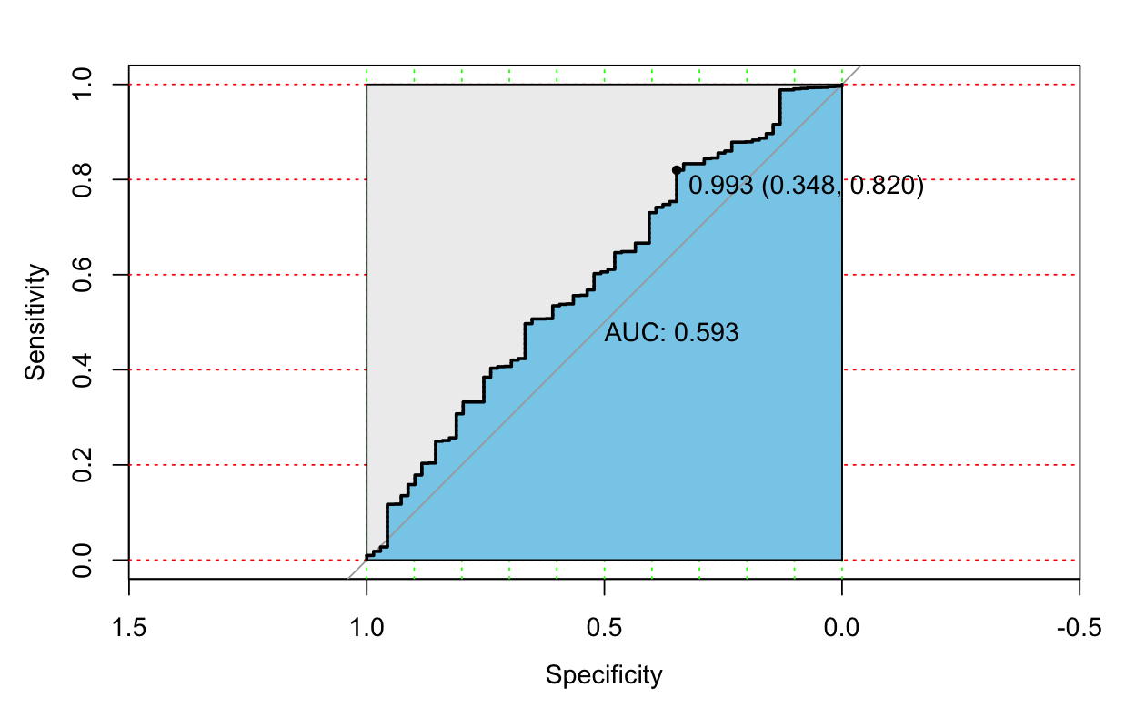
Naive Bayes Model
With Good & Bad Debts
(-) Accuracy
Without Good Debts
Without both Good & Bad Debts

